Slide 1
UNIT I – BASICS OF SDN
UNIT I – SESSION 1
SESSION 7
Centralized Control Planes
Logical Versus Literal
ATM/LANE
Route Servers
Reference: Ref. 2, Ch. 2 (Page. 37 to Page 44)

Slide 2
Centralized Control Planes

Slide 3
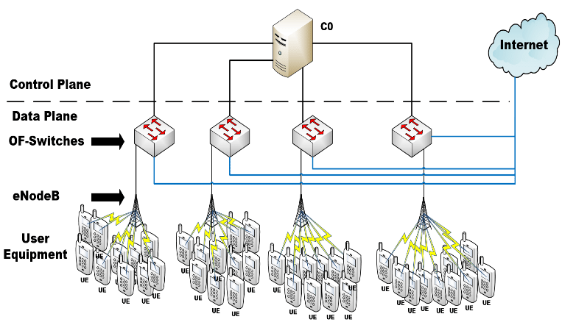
Centralized Control Planes
The primary advantage of a centralized control plane is the view of the network it can provide to an application and the simplification of programmatic control.
To achieve an end-to-end change in a large network, the application no longer has to know of or directly touch the individual elements, but interacts instead with a few control points that take care of these details.
IETF has attempted to tackle some aspects of what are now considered SDN. These included the separation of control/data planes through both ForCES (RFC 3746) and Generalized Switch Management Protocol (GSMP—RFC 3292).

Slide 4
Logical Versus Literal
To discuss a centralized control plane, it is necessary to separate the logical from the literal.
Factors such as the following make literal centralization of control extremely difficult and perhaps undesirable:
Scale:
A central controller will support a control session with each managed device.
As the scale and volatility of the network increases, updates to an individual element require increases in per-session I/O and processing.
Additional features such as collecting analytics through the channel or performing other management tasks, presents an additional burden.
At some point, it makes sense to divide the burden into more manageable pieces

Slide 5
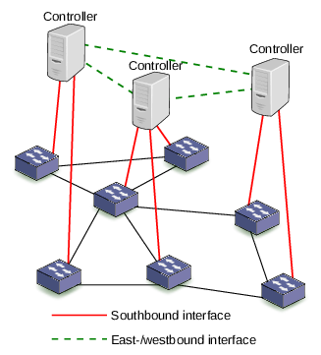

Slide 6
Logical Versus Literal
High Availability
Even if the control session scale burden can be handled by a single controller, that controller becomes a single point of failure that would result in the entire network failing.
Even if the entire network is configured to operate “headless” for a significant period, at some point other network failures or changes will need interaction with the controller.
If the controller has not been restored by then, this will be a problem.
The simplest high availability strategy would allow for an active/standby combination of controllers

Slide 7
Logical Versus Literal
Geography
Within a data center, almost everything managed is relatively close even if your data center is many city blocks or many stories tall.
Once the controller and controlled element are separated by a metro, state, or national network, transmission delay can begin to affect the efficiency of operation.
Greater geographies also increase the risk of partition (separating the controller from the element).
Given these factors, a logically centralized but physically distributed control plane seems to make more sense.

Slide 8
ATM / LANE-as a case of centralized control
Asynchronous Transfer Mode (ATM) is a connection-oriented cell switching and multiplexing technology (standardized through the ITU-T).
Most of ATM’s function was supporting two types of services; static circuits (permanent virtual circuits) and the later developed dynamic circuits (switched virtual circuits).
SVCs are dynamically set up (and torn down) using a signaling protocol between the endpoints and the switches on a well-known channel (VPI/VCI pair).
LAN emulation (LANE) emerged as an ATM Forum-defined specification that makes an ATM network appear (to higher layers) much like an Ethernet (or Token Ring) network—providing the same MAC-layer service interface.
It creates an overlay on the ATM switching underlay and was transparent to the switches.

Slide 9
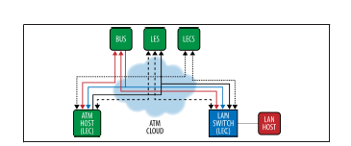
ATM / LANE
To create this overlay, some ATM-connected, role-specific servers were required and offered through one or more controllers. This is illustrated in Figure. The required servers were the LES, the LEC, and the BUS

Slide 10
The LES (LAN Emulation Server) provided a MAC registration and control server (one per emulated LAN) to LAN Emulation Clients (LEC)—essentially, the role of ARP server for the ELAN (LE-ARP).
The LEC was the protocol interface on the host (or element) between the MAC and higher layer protocols.
The LES was paired with a BUS. The BUS (Broadcast and Unknown Server) was a multicast server that handled BUM traffic for a specific ELAN.
The LECS (LAN Emulation Client Server) maintained a domain-wide database of LEC/ELAN mappings was a query point for this level of resolution (providing the ATM address of the LES serving a specific ELAN).

Slide 11
The LECS addresses were manually configured on the ATM switches and discovered (by end stations) through either ILMI, a well-known ATM NSAP address for the LECS or a connection on a well-known channel (VPI/VCI pair).
The clients connect to the servers via bidirectional control-direct (LES) and configuration direct (LECS) VCC.
The clients connect to the BUS as a leaf of a point-to-multipoint VCC
From an SDN perspective then, ATM switching had static and dynamic controls that created an underlay.( Control was not programmatic)
LANE provides a specific type of logical overlay, supported by multiple servers (controller-like functionality,not programmatic)

Slide 12
Route Servers-as a case of centralized control
The route server evolved as a means for Internet service providers to handle the scale of peers and policies at external peering points.
A slightly different mechanism (the route reflector) was standardized for this purpose for internal peers.
A route server is an eBGP-based control that receives control state up‐ dates (NLRI-Network Layer Reachability Information) from each participant, applies filters and policies to those updates, calculates best path based on the resulting data (which could be different than normal BGP best path based on this intermediary policy step), and creates a per-participant RIB (that is returned to the participant) and shown in Figure.
The route server is transparent as far as attributes like AS path. Each participant needs only a single BGP session for the exchange.

Slide 13
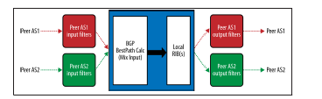
From an SDN perspective, the main problem with the BGP-based control point today is a lack of standardized programmability.
Some would argue that RPSL (Route Policy Specification Language) is a standard for expressing/programming BGP policy in a route server.
However, this is not a complete/adequate solution (missing a standard API, transaction orientation) for a generalized BGP control point like a route reflector.
Some ISP’s use in-house developed tools that process RPSL database files directly and help in the automation of their BGP controls.

Slide 14
An autonomous system (AS)
An autonomous system (AS) is a collection of connected Internet Protocol (IP) routing prefixes under the control of one or more network operators on behalf of a single administrative entity or domain, that presents a common and clearly defined routing policy to the Internet

